Slide 2
“Information Governance in Action”
ROT CAN CONSUME FROM
25% TO 75%
OF FILE SHARE DATA.
Obsolete is typically the highest percentage, with
Redundant the lowest.
Presented by

Slide 3
Let’s talk ROT!
Jeff Tujetsch,
Sale Engineer & Solutions Architect at Gimmal
Jason Velasco,
Chief Executive Officer,
Kindato
#IGW23

Slide 4
Unstructured Data Growth
IDC - Data Age 2025: The evolution of data to life critical 2IDC - Data Management Solutions Review
#IGW23

Slide 5
Examples
Files
Email
Desktops/Laptops
File Shares
Box
Google Drive
OneDrives
Exchange
Gmail
#IGW23

Slide 6
RISKS
Data Leakage
Hacks
Ransomware
#IGW23

Slide 7
COSTS
Backups
Storage
Time
Fines/Sanctions
Lawsuits
#IGW23

Slide 8
Challenges
Determining ROT vs. non-ROT
Determine what can be used for decisions
Content, Folder Structure, Owner, Properties
Determine what files needs to be secured
Determine what files need deletion
Determine Data Owners
Business Areas and Departments
Labeling
Content, Data Owner, Location
#IGW23

Slide 9
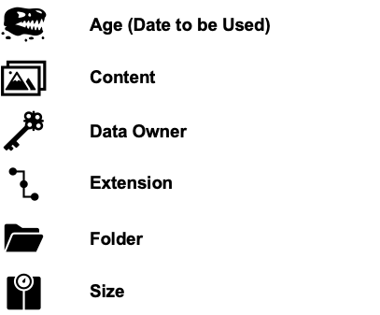
Determining ROT vs. non-ROT
#IGW23

Slide 10
Report Permutation
Age Range (Extension | Folder | Owner)
Size Range (Extension | Folder | Owner)
Extension (Age Range | Size Range)
Folder (Age Range | Size Range)
Owner (Age Range | Size Range)
#IGW23

Slide 11
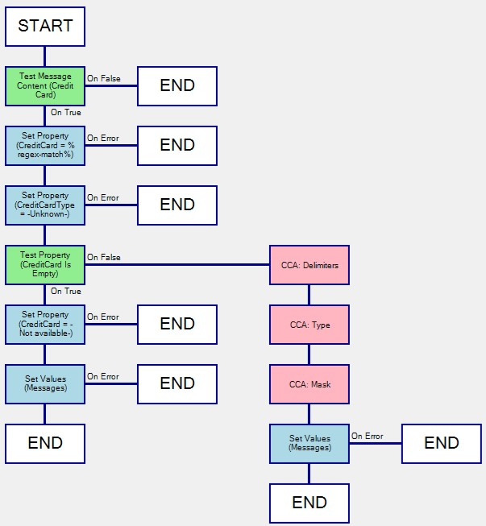
Workflow for Credit Cards
#IGW23

Slide 12
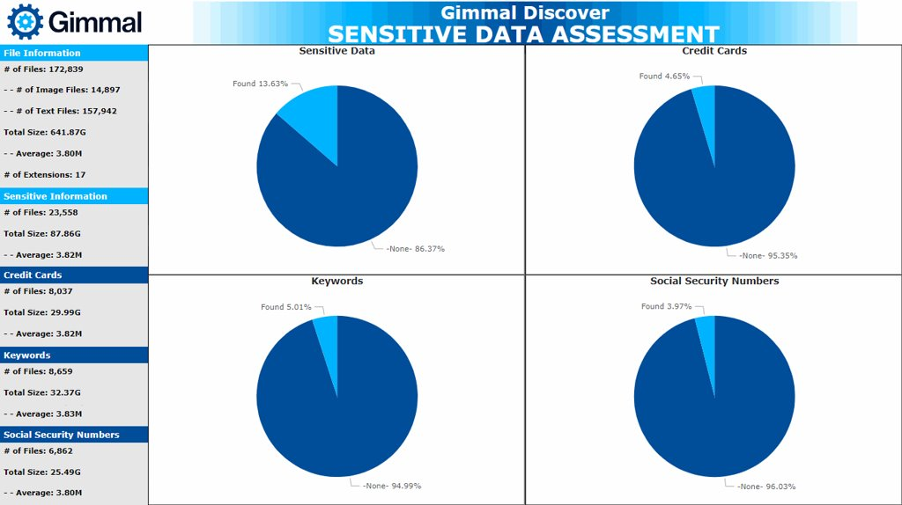
#IGW23

Slide 13
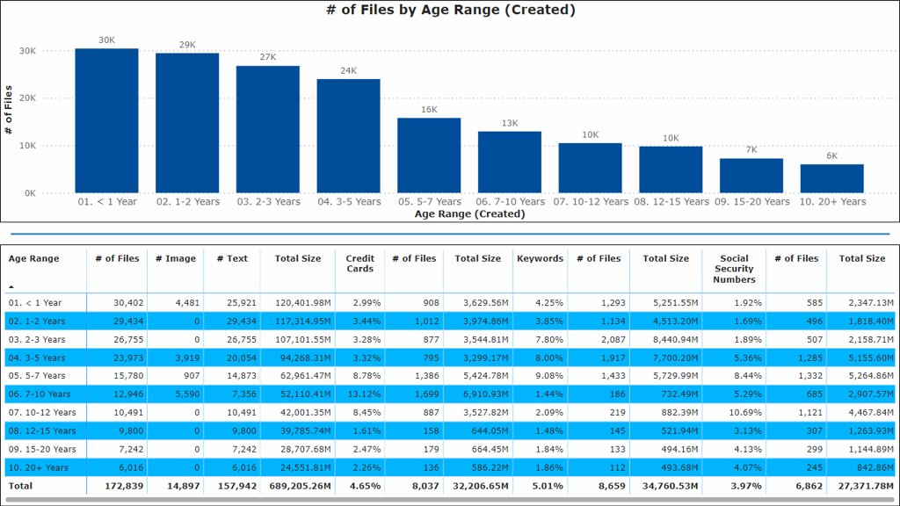
#IGW23

Slide 14
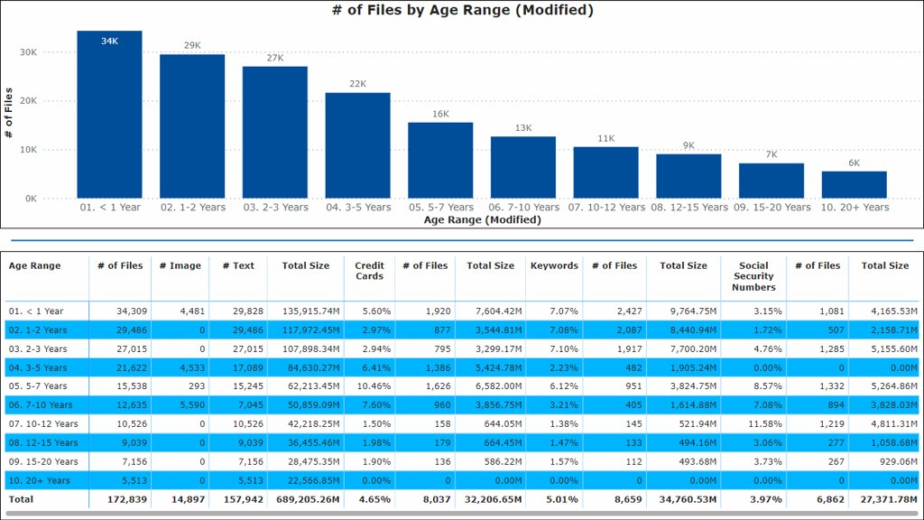
#IGW23

Slide 15
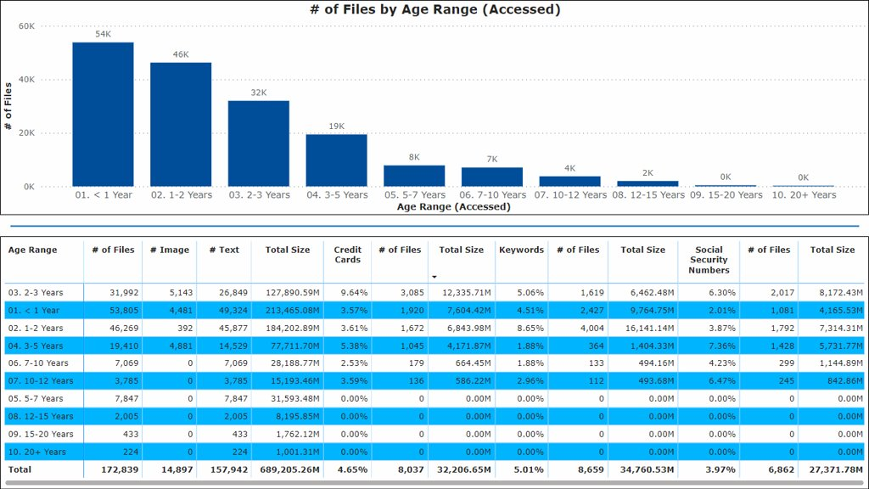
#IGW23

Slide 16
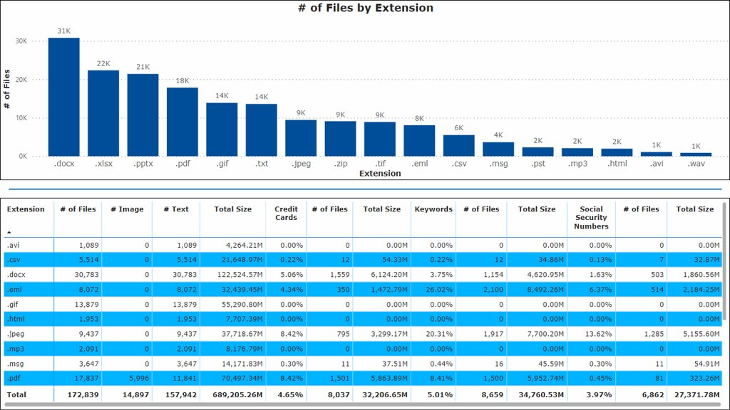
#IGW23

Slide 17
Triage
Analyze redundant files
Remediate redundant files
Nominate a subset of your files
Label all files
Using content?
Using data owners?
Using folder structure?
Using extension?
Analyze all non-labeled files
Perpetual Policy to label all deltas
Perpetual report for all non-label files
#IGW23

Slide 18
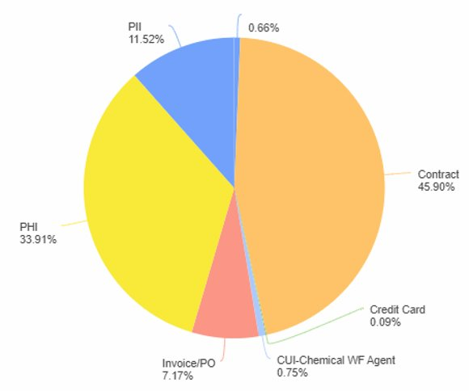
All Results by Label
#IGW23

Slide 19
“Information Governance in Action”
THANK YOU
FOR
ATTENDING!
www.InfoGovWorldExpo.com
Be sure to follow us on LinkedIn! InfoGov World Magazine

Slide 20
Use promocode “gml50” for 50% OFF your registration!

