Slide 1
Who Owns IG Implementations In M365 Migrations?
Gimmal & Kindato - ACEDS Webinar

Slide 2
Agenda
Introductions
Migrations as a Service (MaaS)
Importance of Information Governance
Moving to the M365 Cloud
M365 Migration Implementation Roadmap
IG Roles in M365 Migrations
IG and M365 Maturity Models
Challenges / Tips and Tricks
Q&A
Notes:
JV – 10 seconds and move on

Slide 3
Introductions
Jason Velasco
Dean Misenhimer
CEO
Director of Sales Engineering

Slide 4
About Gimmal
Software customers in over 14 countries
Trusted advisors for over 20 years
A network of global partners
Over 500,000 licensed users
Gimmal software is designed to help organizations govern their information more efficiently to achieve compliance and reduce risks.​
Notes:
Dean provides overview

Slide 5
About Kindato
We specialize in providing innovative technology solutions for Information Governance, eDiscovery, and Modern Work in Microsoft M365.
Our RecQuest applications provide technology solutions for DSAR and Public Records workflows through Microsoft TEAMS and SaaS
Data Migrations + IG
Information
Governance
RecQuest for DSAR &
Public Requests
M365 eDiscovery
We have a wealth of experience in information governance and eDiscovery for Microsoft M365 in financial services, healthcare, and government organizations. We take pride in delivering projects on time, on budget, and to the highest quality standards.
Notes:
- Jason V provides overview

Slide 6
Just Announced: Kindato + Gimmal = MaaS
MaaS + IG
M365 Assessments
Legacy Data Analysis
& Disposition
Lift & Shift Migration
Filtered Migration​
IG Policies &
Procedures
Knowledge & Content
Management
Intelligent Migration
Using AI​
Physical
Records
2023 Gimmal & Kindato
Notes:
JV – Announces
DM – Provide color on types of migrations

Slide 7
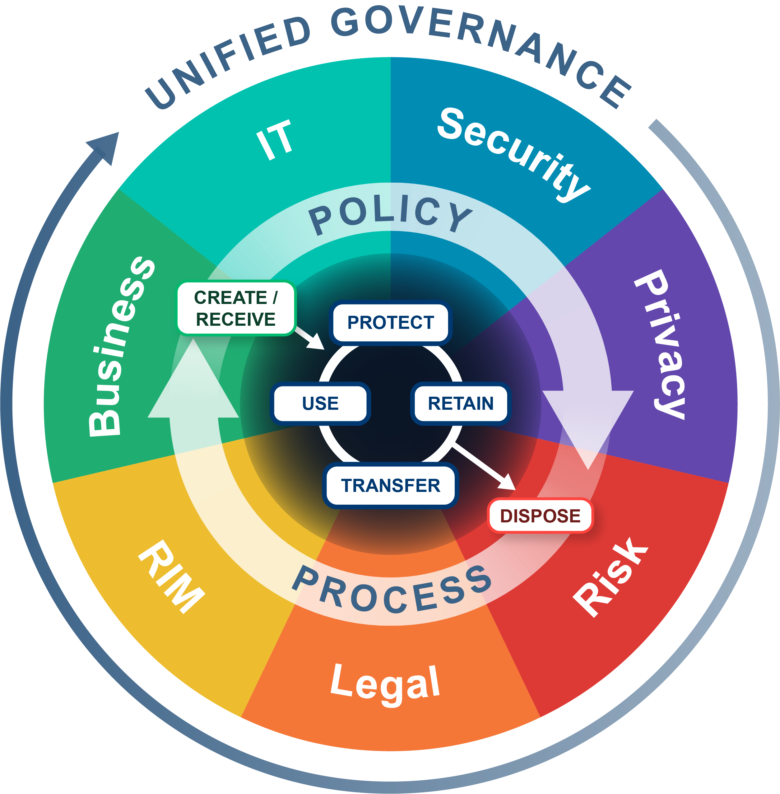
Setting the Stage: Understanding the Importance of Information Governance (IG)
What is Information Governance and why is it important?
Migrations – the perfect intersection of IG, law, and technology
2023 Gimmal & Kindato
Notes:
JV
IGRM – Found on EDRM site – Updated recently – Focus is on balancing value, risk, and cost
Define Information Governance (IG): "Information Governance (IG) is the strategic management of information within an organization. It encompasses policies, processes, and controls designed to manage information throughout its lifecycle."
Transition to the importance of IG: "In a world where data is becoming more abundant and complex, IG is no longer optional but critical. It allows organizations to extract value from their data, improve decision-making, reduce operational friction, and ensure compliance with laws and regulations."
DM
The Intersection of IG, Law, and Technology
Discuss how law and technology intersect with IG: "In the legal industry, IG has a unique intersection with law and technology. The law dictates the 'what' - what information must be retained, for how long, and who should have access. Technology, on the other hand, provides the 'how' - how we store, manage, protect, and access information. Balancing these two elements is the core of effective IG.“
Add’l points if time
How IG Impacts Legal Operations and Workflows
Talk about how IG affects operations: "IG has a significant impact on legal operations and workflows. Proper IG reduces risks related to non-compliance, litigation, and data breaches. It also enhances productivity by enabling efficient information access and use. Furthermore, effective IG can lead to improved client trust and satisfaction due to better data handling and protection."
IG is a key pillar in the legal industry. It’s not just about compliance or risk mitigation – it’s about leveraging our data to its full potential for a competitive edge. This ties into how you can gain knowledge and insight about the data

Slide 8
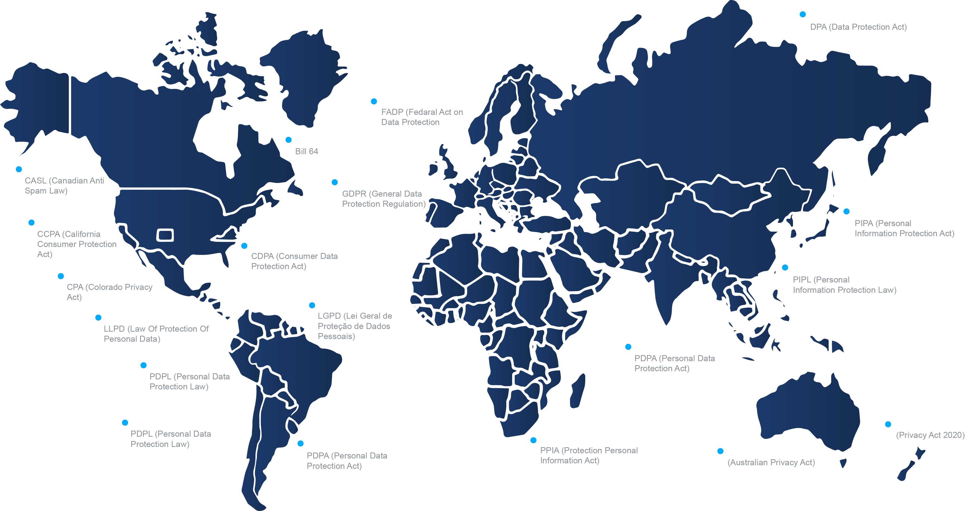
Legal and Regulatory Aspects of IG
Legal and regulatory landscape related to IG increasingly complex
Consider impact of data privacy, compliance, and cybersecurity on data movement
Data migration strategies are impacted by these regulations
Legacy content sources like file shares and ECM systems are sources of dark data
2023 Gimmal & Kindato
Notes:
- JV Sets up
- DM – picks up Dark data talking points: original creators are long gone, current users afraid to delete data, sheer quantity makes it difficult to review

Slide 9
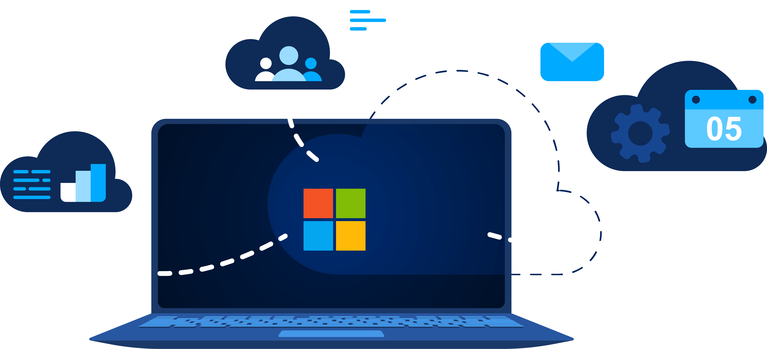
Moving to the M365 Cloud
2023 Gimmal & Kindato
Notes:
DM – Importance of moving to cloud and why M365 in particular

Slide 10
M365 Migration Implementation Roadmap
Validation QA/UAT
Conduct Migrations
Pre-Migration Analysis
Prepare Destination (SharePoint Office)
Communications and Change Management Activities
Business Department Pre-Migration Activities
2023 Gimmal & Kindato
Notes:
DM
Who do you start with? You can’t do everything in one weekend. Who’s open to migration and who’s resistant?
Test and validate. Capture and review logs, review results
Change management and communication is key! When do you do a content freeze? How long do you leave the legacy content available?
Validation: Pre-migration testing, Design Review, Migration, Validation of data, User acceptance testing

Slide 11
IG Roles In M365 Migrations
Information Governance
Officer (IGO)
Data Protection
Officer (DPO)
Data Stewards
Oversees entire migration process
Establishes polices
Sets guidelines for data quality, compliance, security, and life-cycle management
Coordinates internal and external teams
Ensures compliance with data protection laws
Conducts Data Protection Impact Assessments (DPIA)
Implements data security measures
Serves as custodians of data quality
Responsible for data classification and clean-up
Ensures metadata correctly attributed
Tracks data lineage
Maintains data catalogs
2023 Gimmal & Kindato
Notes:
JV – IGO, DPO
DM – Data Stewards

Slide 12
IG Roles In M365 Migrations
IT Team / Database Admins
Legal Counsel
Change Management Teams
Project Manager
Migration execution
Manages the migration tech selection and usage
Ensures data integrity during transfer
Implements necessary security protocols
Can be internal or external
Navigates complex legal and regulatory data landscape
Advises on compliance issues, data privacy, and legal risk
Facilitates the transition for users
Plans and executes training
Supports users during and after the migration
Address resistance to change
Manages project schedule & progress
Manages budget
Manages team coordination
Communicates with stakeholders
2023 Gimmal & Kindato
Notes:
DM – IT Team/DBA
JV – Legal
DM – Change Mgmt
JV – Project Manager

Slide 13
IG Maturity Model
Level 5:
Optimized
Information re-use and value growth practices in place
Master metadata connects and unifies content from diverse sources for new value
Level 4:
Managed
Information risk and quality supports mgt reporting
Value based content metrics defined and measured; information quality dashboards in place
Assessing your organization's IG maturity before migration
Case study: Successful application of the IG maturity model at academic institution
Level 3:
Defined
Content managed across project lifecycle
Automated monitoring for key content policies; analysis, clean-up and metadata creation services in place
Level 2:
Repeatable
Small body of proven information practice and processes
Defensible disposition for key projects and departments; Repeatable FOIA and legal hold collection processes
Level 1:
Initial
Chaotic information stores
Discover and inventory content; clean-up and reduce storage burden. Gain stakeholder support
2023 Gimmal & Kindato
Notes:
- JV – Walk through IG Maturity Model

Slide 14
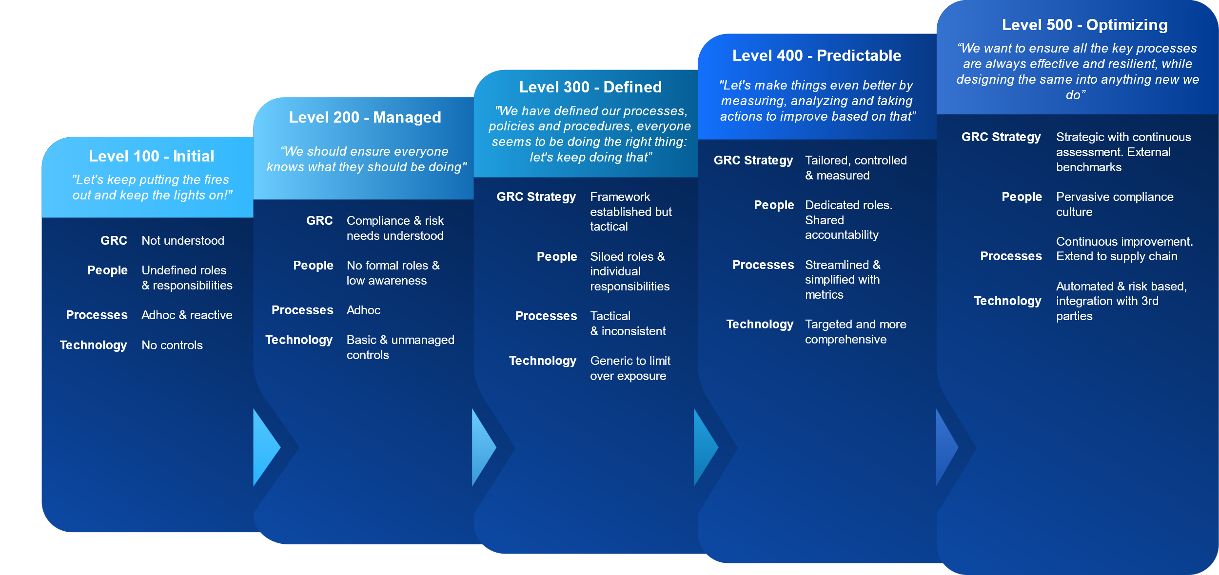
M365 Adoption: Preparation & Execution
Preparing your organization's infrastructure for M365 adoption
GRC considerations in deciding SharePoint sites
Data migration considerations specific to M365 and SharePoint Online
2023 Gimmal & Kindato
Notes:
DM Talking points:
Do you have site and library structures defined?
Content types and metadata to receive legacy system data?
How will you mange governance in M365? Purview? Third-party solution? Do you have the data you need to adequately apply governance?

Slide 15
M365 Data Migration: Challenges and Best Practices
Poor Data Quality Source System Perhaps even unknown data types
No Time for Data Clean Up
“we’ll clean it up after we migrate”
Time & Budget Greatly Reduced
Due to being conducted near the end of the future state repository
Incomplete Analysis/Planning
Challenges when exceptions are encountered
IT Resource Strain
Long migrations suck up IT resources. Look to external resources.
Throttling
Forced to migrate to cloud environments such as Box and M365
2023 Gimmal & Kindato
Notes:
- DM kicks off and runs, JV will provide color commentary
Lift and shift approach? Some cleanup and data mapping? Or detailed analysis and cleanup during migration?
When is your renewal? Are you battling the clock?
Links to legacy content? How will you manage those?
Success is a combination of people, process and technology!

Slide 16
M365 Migration Tips
Use the Right Tools
Clean Your Data First
Map Your Metadata
Plan for Security and Compliance
Test, Test, Test Before Full Migration
Have a Plan to Manage Versions
Training and User Support is Critical
Phased Migrations Reduces Risk
Monitor and Optimize – AI and Analytics can Help
2023 Gimmal & Kindato
Notes:
JV will lead and DM will provide color commentary

Slide 17
4-Step Checklist for Success
1
Migration Planning
Migration Strategy – Big bang vs. Departmental vs. Some other segmentation. Get the team together
2
Conduct a Content Analysis
Does everything need to go? Defining migration criteria? Content clean up?
3
Validation
Does the migrated content work as expected? What about failures and exceptions? Did we get everything?
4
Communication
Freezing source system vs. delta migration? Cutover to future state and then migrate?
Change management associated with how to access migrated content and potential changes.
2023 Gimmal & Kindato
Notes:
Who do you start with? You can’t do everything in one weekend. Who’s open to migration and who’s resistant?
Test and validate. Capture and review logs, review results
Change management and communication is key! When do you do a content freeze? How long do you leave the legacy content available?
Validation: Pre-migration testing, Design Review, Migration, Validation of data, User acceptance testing

Slide 18
Q&A Session
Notes:
Sample Pre-Canned Questions:
1. Question on Data Migration: In the context of a law firm, what are some common challenges faced during data migration to Microsoft 365 and how can we overcome these?
2. Question on Compliance: Given the nature of sensitive legal data, how can we ensure that our information governance practices meet all necessary regulatory and compliance requirements when migrating to a new platform?
3. Question on IG Maturity: Can you elaborate on the stages of the IG maturity model and provide some practical steps on how we can move our organization towards a more mature stage of information governance?
Talking Points Below:
Data Migration Challenges and Solutions in a Law Firm Context:
Challenge: Legacy data and systems may not be compatible with M365, which can lead to technical difficulties during the migration process.
Solution: Pre-migration assessments can help to identify potential incompatibilities and provide an opportunity to clean and structure data in preparation for migration.
Challenge: Law firms often deal with a large amount of sensitive information that needs to be securely transferred and properly classified in the new system.
Solution: Using the right tools for the migration, such as those provided by Microsoft, and conducting comprehensive security and compliance checks can help ensure data is transferred securely and correctly classified.
Challenge: Training staff on how to use the new system can be a complex task that requires time and resources.
Solution: Implementing a strong training program and providing ongoing support to staff can help facilitate a smooth transition to the new system.
Ensuring Compliance in Information Governance Practices During Migration:
Regular audits and assessments of the information governance program can help ensure ongoing compliance with regulatory requirements.
Leveraging M365's inbuilt compliance tools, such as Advanced Data Governance and Compliance Manager, can help maintain and monitor compliance throughout the migration process.
Collaborating with legal and compliance teams throughout the migration process can ensure that all decisions and processes are legally sound and meet all necessary compliance standards.
Implementing strict data classification and protection policies can help safeguard sensitive data during and after migration.
Stages of the IG Maturity Model and Steps Towards More Mature IG:
The IG maturity model typically comprises several stages, from initial (reactive IG practices, ad-hoc policies) to transformational (proactive IG practices, integrated and automated policies).
To move towards a more mature stage of IG, organizations can begin by conducting a thorough IG maturity assessment to understand their current position and identify areas for improvement.
Developing a strategic plan for IG improvement, including clear objectives, responsibilities, and timelines, can provide a roadmap for progress.
Implementing IG tools and technologies can help automate and streamline IG processes, facilitating a shift towards more proactive and integrated IG practices.
Regular monitoring and review of IG practices can ensure ongoing improvement and movement towards a more mature stage of IG.

Slide 19
Dean Misenhimer
Contact Info:
Dean.Misenhimer@gimmal.com
Gimmal.com
Jason Velasco
Contact Info:
Jason.Velasco@kindato.com
Kindato.com
2023 Gimmal & Kindato

